Slide 1


Цифровой прорыв СЗФО «Обнаружение объектов при помощи анализа видеоинформации»
IN AIR DETEKTOR
Команда “AltioremScientiam”

Slide 2


ПРОБЛЕМАТИКА
1
Влияние человеческого фактора в системе безопастности производств
2
Трудозатратность обработки данных с множества камер человеком
3
Необходимость в повышении уровня безопасности в сфере наблюдения за гражданскими и промышленными объектами

Slide 3


РЕШЕНИЕ
Создание программы, способной обнаруживать объекты по видео с помощью искусственного интеллекта

Slide 4
ВИЗУАЛИЗАЦИЯ РАБОТЫ ПРОГРАММЫ

Slide 5

ЭКОНОМИЧЕСКИЙ ЭФЕКТ РЕШЕНИЯ
Удешевление технологий безопсности
В связи с автоматизацией процессов безопасности, появится возможность сокращения штата охраников

Slide 6


DISCOVER OUR SERVICES
BRAND BUILDING
DIGITAL MARKETING
We create a strong brand identity, including logos and design elements, to help startups stand out and gain trust.
We develop effective online marketing strategies using channels like social media, email, and ads to reach potential customers.
MARKETING ANALYTICS
PR SUPPORT
We provide insights and reports on marketing performance to help startups make informed decisions.
We help startups get media coverage and build relationships with relevant journalists and influencers.

Slide 7
SIZE OF MARKET
Serviceable Obtainable Market: 480 K
Understanding the market size is important for us. In the US, there are about 32 million small businesses. We're aiming at industries like technology, e-commerce, and professional services, which are about 30% of all small businesses. That means we're looking at around 9.6 million potential customers. Our goal is to get about 5% of them, which would be roughly 480,000 businesses. This helps us know who to target and plan our growth strategy.
Serviceable Addressable Market: 9.6 M
Total Addressable Market: 32 M

Slide 8
DIRECT COMPETITOR
INDIRECT COMPETITOR
Offers similar services or products to ours.
Targets the same customer base and market segments.
Competes directly with us in terms of pricing, features, and positioning.
Can be easily identified and recognized as a competitor by customers and industry analysts.
Provides different services or products that solve similar customer needs or problems.
Targets overlapping or adjacent market segments but may not directly compete with us.
Might offer complementary products or services that could substitute or supplement ours.
Can include companies from different industries or sectors that indirectly impact our market.
Ingoude Company

Slide 9

KEY COMPETITIVE ADVANTAGES
Expert Team
Customer Focus
Our skilled team brings specialized knowledge and experience to provide top-notch solutions tailored to our clients' needs.
We prioritize building strong relationships and understanding our clients' needs, leading to long-term partnerships based on trust and satisfaction.
Cutting-Edge Technology
Proven Success
We use the latest tools and technology to stay ahead, ensuring efficient and effective services.
With a track record of successful projects, we've earned a reputation for reliability and excellence, setting us apart from the competition.

Slide 10
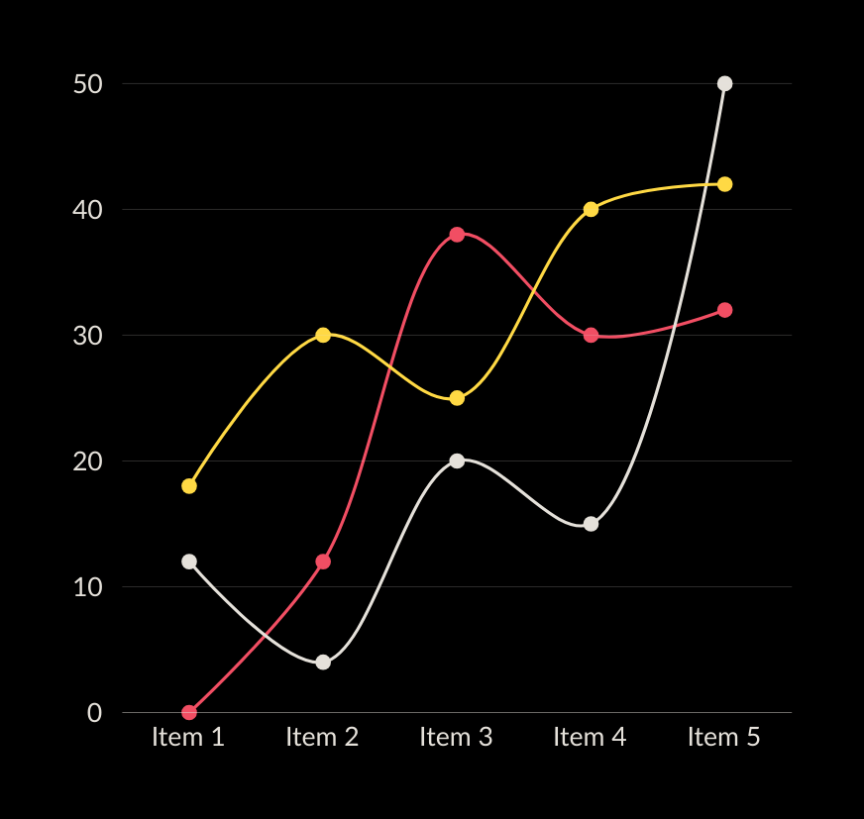
TRACTION
This matrix provides a snapshot of various success metrics for our company, including revenue growth, customer satisfaction, market share, employee retention, innovation, and brand reputation.
20% annual revenue growth
90% maintain customer satisfaction ratings
15% market share in key segments

Slide 11
REVENUE MODEL
Basic Plan
Standard Plan
Premium Plan
Pricing | 135$/ month | 175$/ month | 220$/ month
Features | Limited features Basic support No customization | More features Standard support Some customization | Full features Priority support Full customization
Usage Limits | Limited usage Limited storage | Increased usage More storage | Unlimited usage Unlimited storage
Additional Services | No additional services included | Optional add-ons available for purchase | Premium support and consulting included

Slide 12
ACCOMPLISHMENTS DATE
2021
2023
2025
Present
In our first year, we successfully launched a new product/service, received positive feedback from early users, and formed partnerships with key industry players.
We expanded into new markets, improved operational efficiency, and saw an increase in customer satisfaction.
We secured funding for growth, refined our offerings based on customer feedback, and formed strategic partnerships.
We achieved profitability, expanded our product line, and strengthened our brand reputation through positive customer feedback.

Slide 13
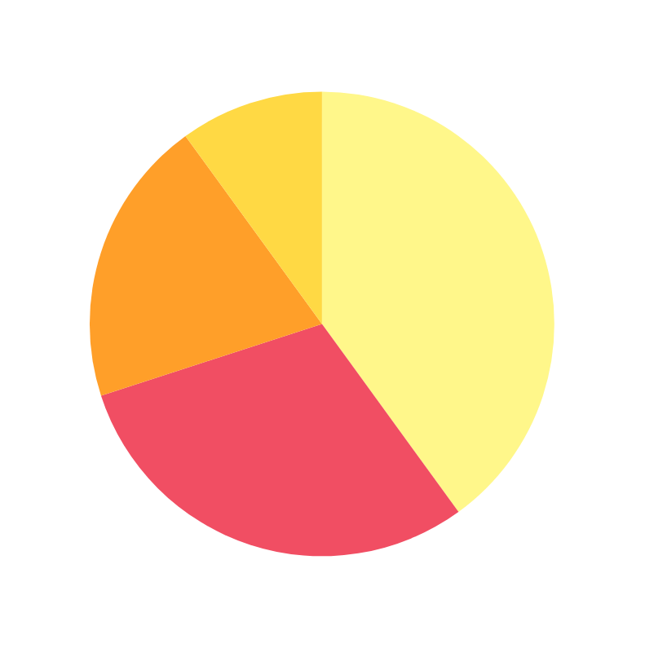
USE OF FUNDS
Our plan for using funds generated from investors is straightforward. We'll allocate 40% towards further developing our products, ensuring they stay competitive and meet customer needs. 30% will go into marketing and sales efforts to attract new customers and drive revenue growth. 20% will be invested in infrastructure and operations to support our expanding business and improve efficiency. Finally, 10% will be set aside for strategic initiatives like market expansion and partnerships to fuel long-term growth.
A. 40% Product Development
B. 30% Marketing and Sales
C. 20% Infrastructure and Operations
D. 10 % Expansion and Growth Initiatives

Slide 14
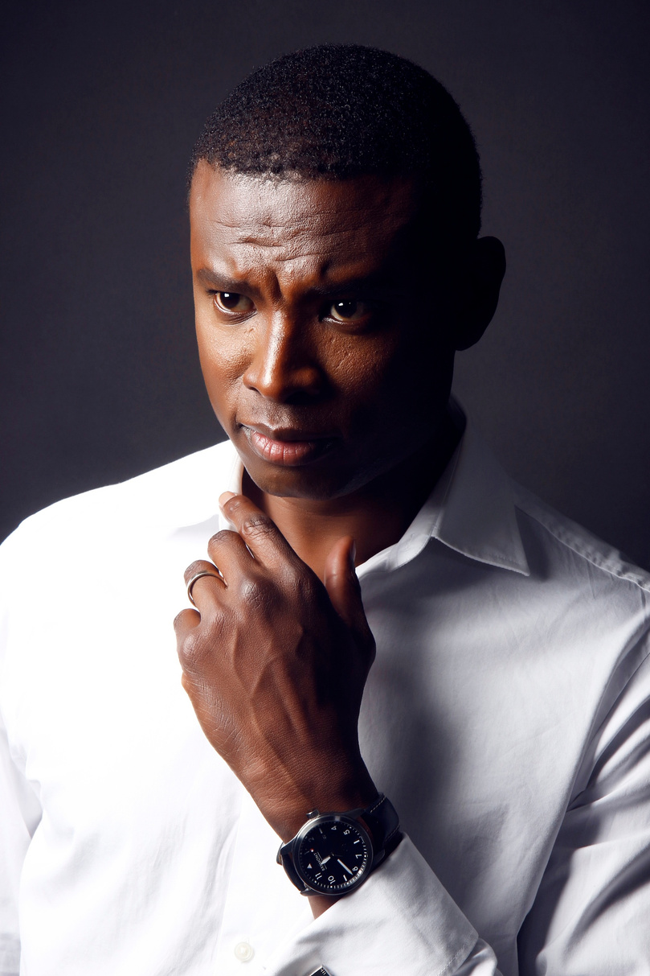
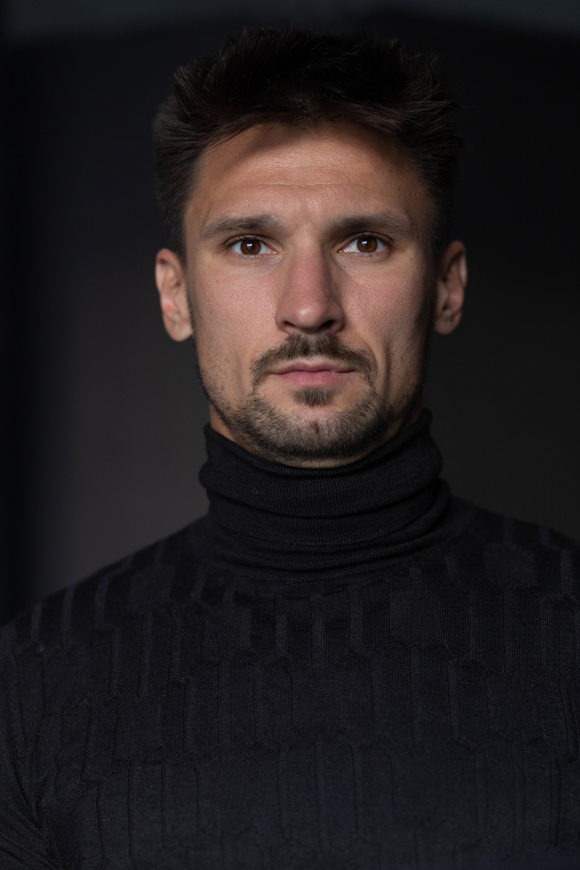

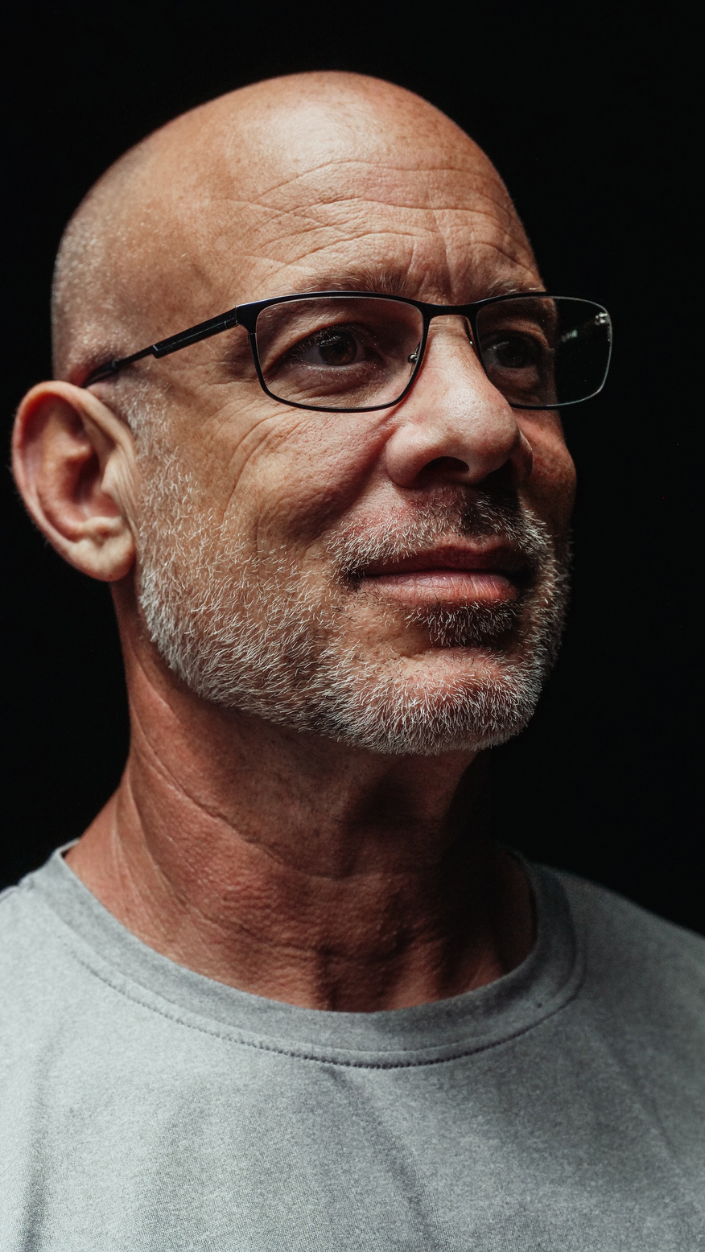
MEET THE TEAM
Thank you for your time! Reach out to us for questions.
DANI MARTINEZ
HARPER RUSSO
MORGAN MAXWELL
NEIL TRAN
Chief Executive Officer
Chief Executive Officer
Chief Executive Officer
Director

Slide 15



Ingoude Company
THANK YOU
for your time and attention
Present by Neil Tran
www.reallygreatsite.com
hello@reallygreatsite.com
123 Anywhere Street., Any City

